Slide 1
Let’s find out about
Click on the link below.
Each tab will tell you more about Spring,
its weather and the animals born
during this season.
https://www.topmarks.co.uk/Spring/WhatIsSpring.aspx

Slide 2
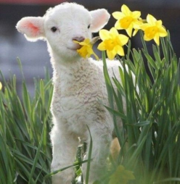
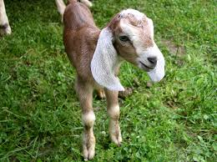
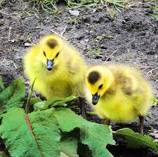
EYFS activity: Draw a picture of an animal
born in Spring.
KS1 activity: Try out the animal matching
and sorting games on the link below:
http://www.crickweb.co.uk/ks1science.html

