Slide 1
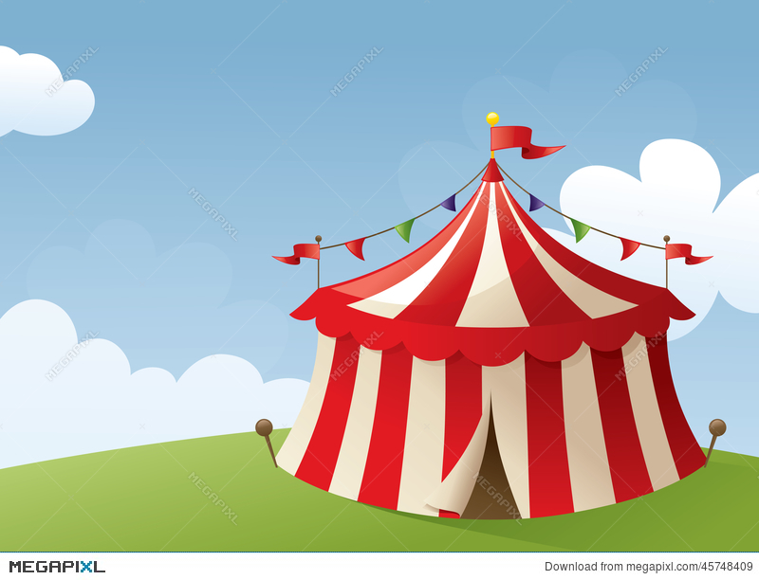
Today you’re going to use your skills to work as a team and create your own circus act.

Slide 2
Last week you went on a sensory journey to the circus with your families. Can you remember some of the acts you saw in the video? This week we would like you to work as a team with your family to create your own circus performance. You could try your hand at juggling, or dress up like a clown. Maybe you could perform some acrobatics from the gymnastics you have learnt in school. How did it make you feel to perform your act? Did you feel nervous or excited? If you felt nervous, how did you overcome this? I would love to see some of your performances, so remember to take a photo or video and send them into school.

