Slide 1
Is your child ready for school?

Slide 2
What does “school ready” mean?
Having strong social skills
Can cope emotionally with being separated from their parents
Have a curiosity about the world and a desire to learn
Are relatively independent in their own personal care.

Slide 3
5 Top Tips for getting you child ready for school
Support you child’s independence.
Build up your child’s social skills.
Make a start on early literacy and numeracy skills.
Help you child to concentrate.
Talk to your child about school.

Slide 4
1. Support your child’s independance
Going to the toilet
Getting dressed
Putting shoes on
Eating
Solving simple problems

Slide 5
2. Build up your child’s social skills
Organise play dates.
Practising greetings.
Practising conversations.
Encouraging sharing and tolerance.

Slide 6
3. Make a start on early literacy and numeracy skills
Help them recognise their name.
Share stories.
Hone fine motor skills.
Introduce them to numbers.

Slide 7
4. Help your child to concentrate
Enjoy extended play together.
Follow instructions.

Slide 8
5. Talk to your child about school
Reading books
Talk about how fun school is.
Practise the school routine.

Slide 9
First Day at School
The night before
Get everything ready
Talk about the exciting day ahead
Going to school
Leave plenty of time to get there
Take a photo
Say a quick goodbye
After school
Be prepared for a very tired child!

Slide 10
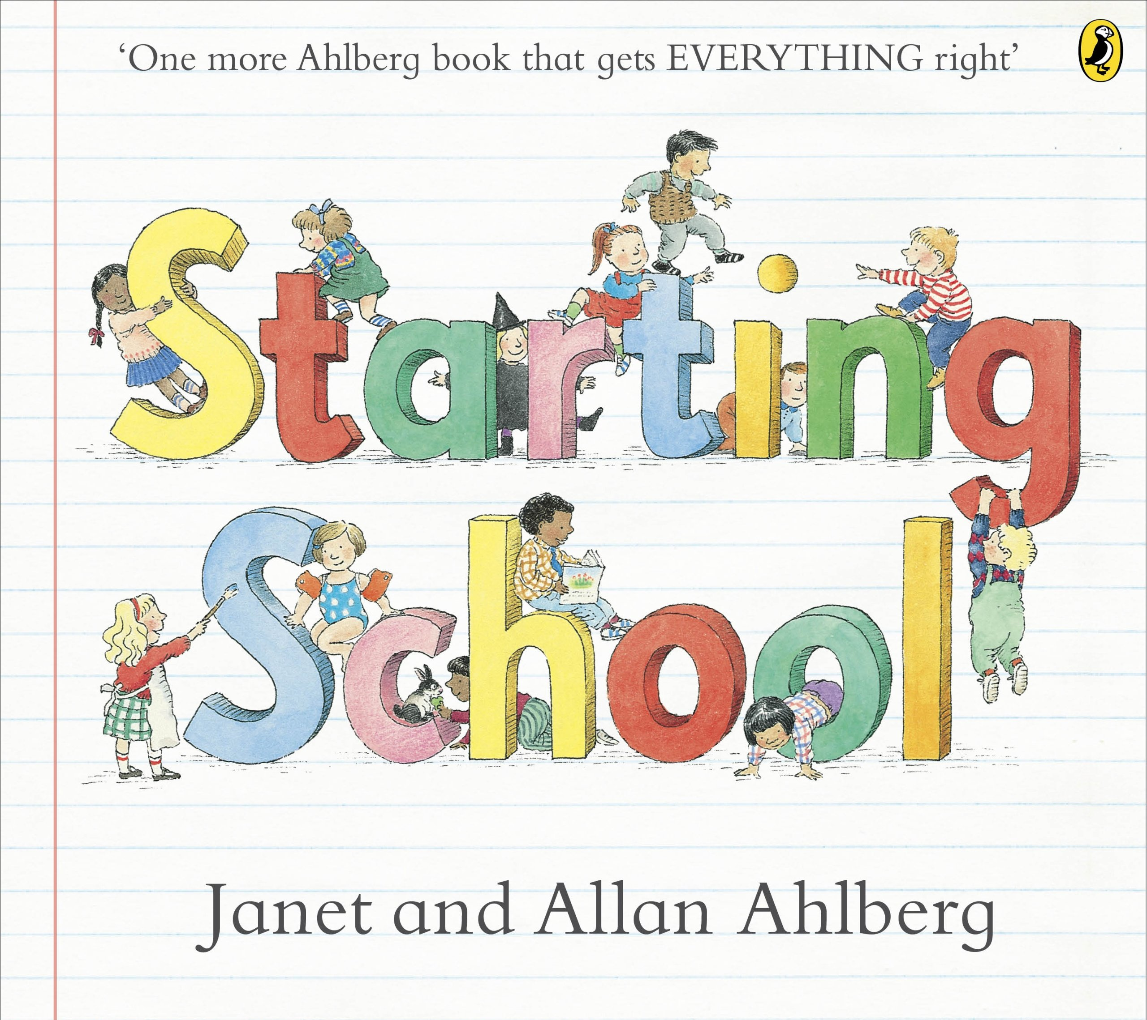
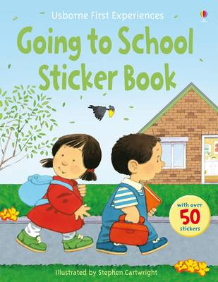
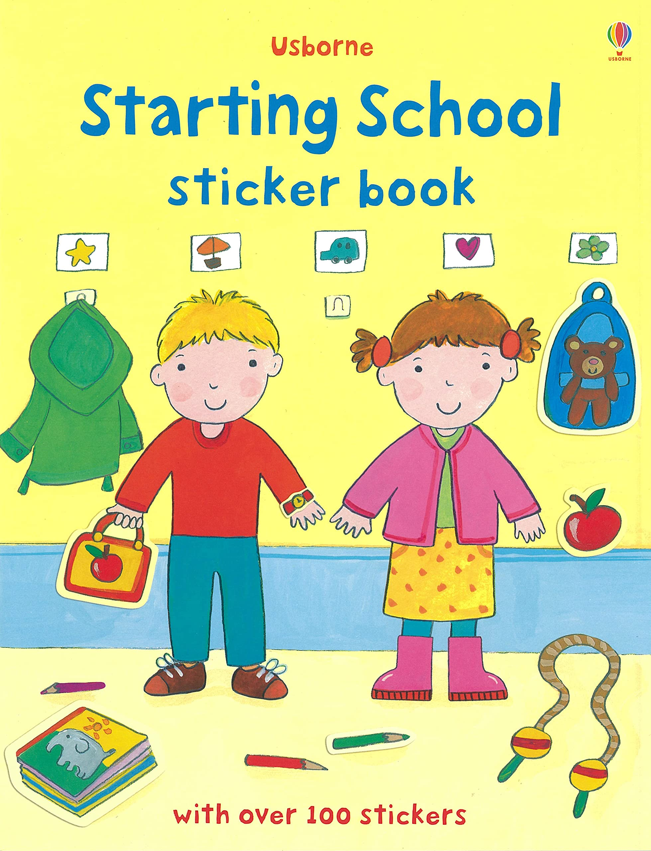
Books

