Slide 1
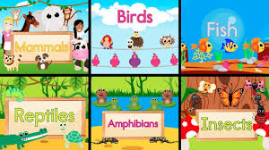
Animals
Do you remember all the animal groups?
Click on the link below and join in with the song!
http://www.viewpure.com/PHYi4fqeEdw?start=0&end=0

Slide 2
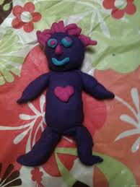
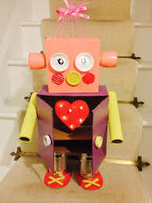
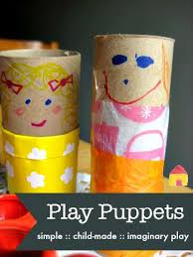
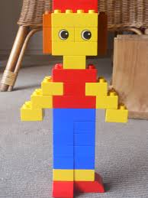
EYFS
Did you know that humans are mammals?
Try making a 3D model of
a person.
You can use junk modelling, lego, playdough or anything you have at home.
Don’t forget to send in your photos!

Slide 3
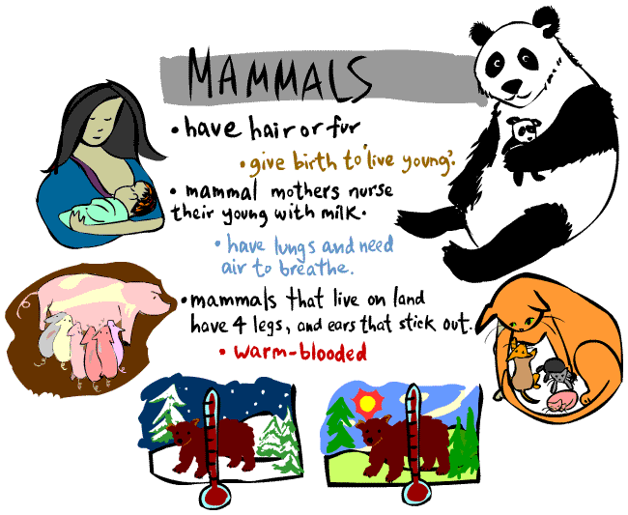
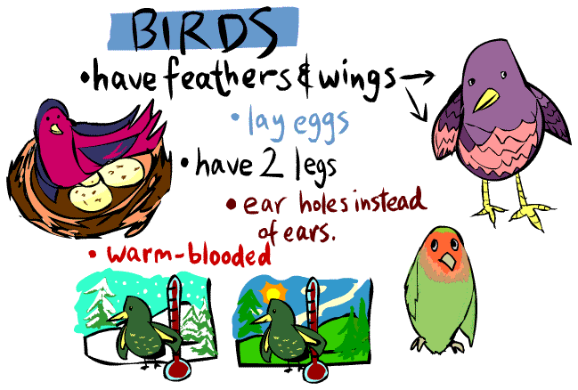
KS1
Can you make a model of each of the groups below?
Can you remember any of the facts?
If so, tell someone or write them down.
Don’t forget to send in your photos!

