Slide 1
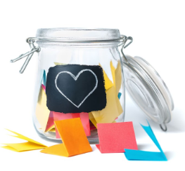
PSHE – All year groups
We are now in our 8th week of Lockdown and you have all been doing incredibly well. However, there are lots of things we are missing about normal life.
This week we would like you to write down/draw all of the things you are looking forward to doing again and collect them in a special wishing pot. This could be a jar, box, cup or bowl and if you’d like you can decorate it with extra magic!
When the Lockdown is over, you can select a piece of paper and finally do what it is that you had been missing.
Don’t forget to send us a photo of your wishing pots!

