Slide 1
Dogsthorpe Infant School
Calculation Policy 2021.
Developed by Miss Colbeck, Maths Subject Leader, in collaboration with staff & Cambridge Maths Hub

Slide 2
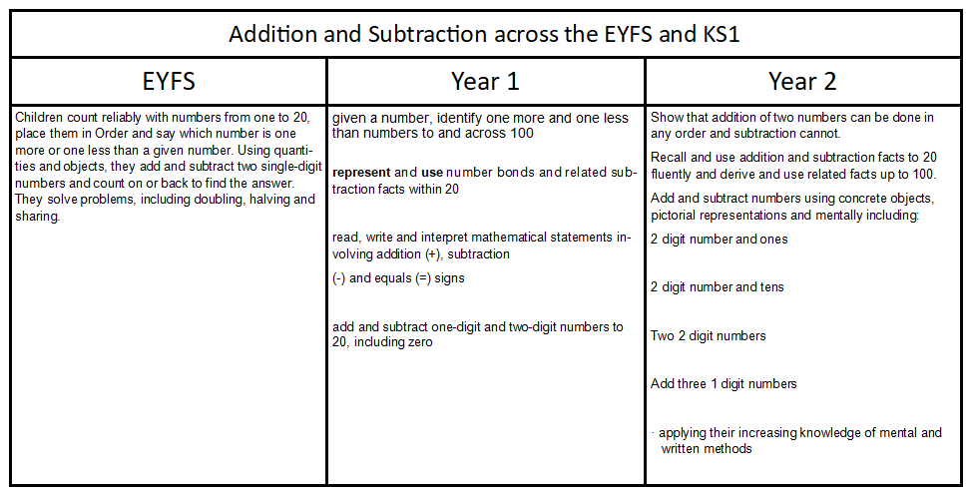
ELG: Number Children at the expected level of development will: - Have a deep understanding of number to 10, including the composition of each number; 14 - Subitise (recognise quantities without counting) up to 5; - Automatically recall (without reference to rhymes, counting or other aids) number bonds up to 5 (including subtraction facts) and some number bonds to 10, including double facts. ELG: Numerical Patterns Children at the expected level of development will: - Verbally count beyond 20, recognising the pattern of the counting system; - Compare quantities up to 10 in different contexts, recognising when one quantity is greater than, less than or the same as the other quantity; - Explore and represent patterns within numbers up to 10, including evens and odds, double facts and how quantities can be distributed equally.
.

Slide 3
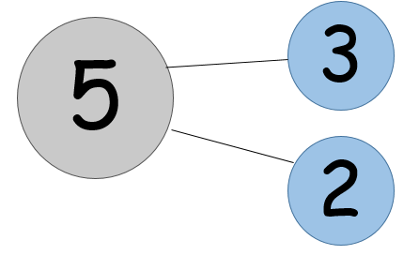
Addition – progression in written methods EYFS to Y2
Addition is commutative because the parts can be added in any order.
There are two structures of addition: aggregation and augmentation.
Combining two or more parts to make a whole is called aggregation.
Ben had 3 footballs and Zoe had 2 footballs. How many footballs are there altogether?
An addition context described by a first, then, now story is an example of augmentation.
Harry had 3 footballs, then he was given 2 more. How many does he have now?
Both structures can be represented on a part/whole diagram.
whole part/part
The sum of the parts is equal to the whole.

Slide 4
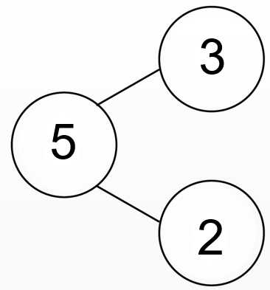
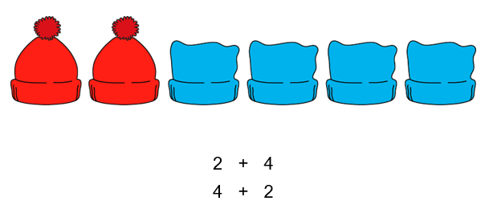
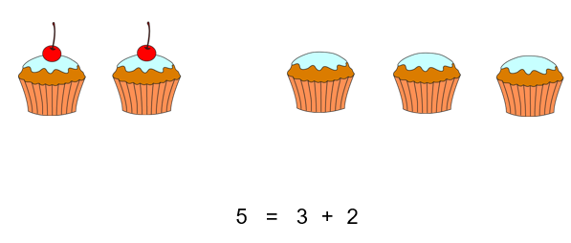
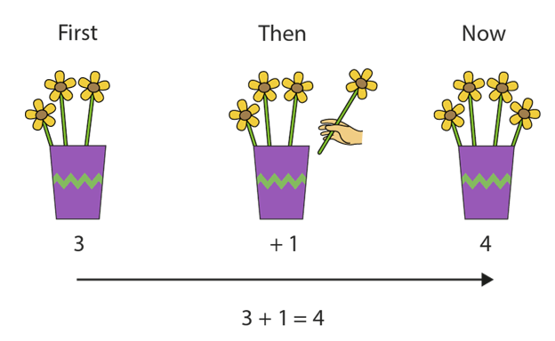
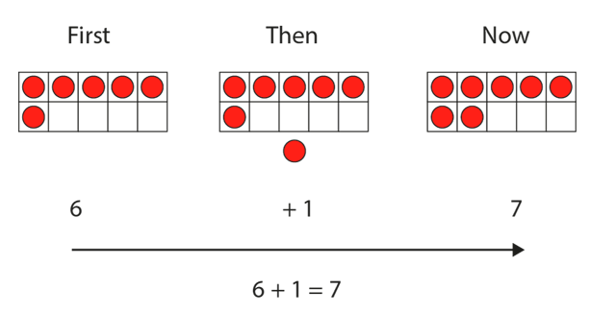
EYFS Objectives (ELG)
1 more
Add two single digit numbers
Count on
Key skills:
Subitise
Count on from any number
Use part whole diagram
Start with expressions (no = sign)
Move on to equations (has = sign)
Aggregation structure
Augmentation structure
Teacher to model the bar model
in summer term

Slide 5
Y1 Objectives
Number bonds and related addition facts within 20
Add 1 and 2 digit numbers to 20, including zero
Key skills:
Adding 0 and 1 to a number
+ bonds within 10 e.g. 5 = 4 + 1
+ bonds = 10
Use part whole diagram (include zero)
Zero is not a part
Start with expressions (no = sign)
Move on to equations (has = sign)
Aggregation structure
Augmentation structure
Teacher to model the bar model

Slide 6
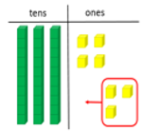
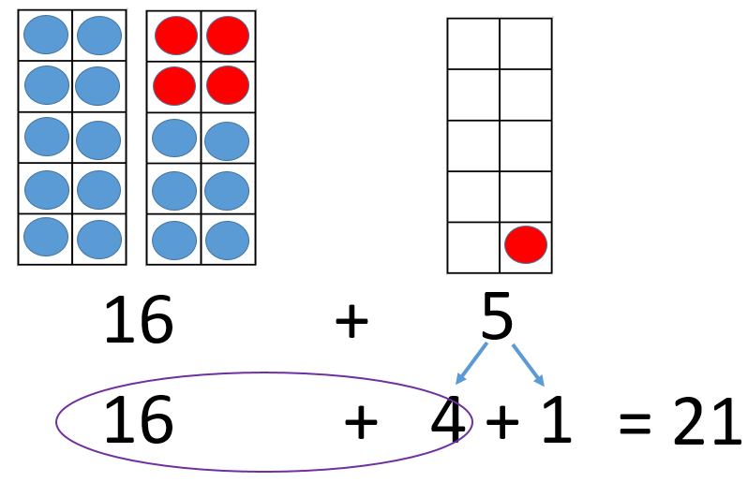
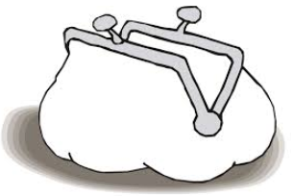
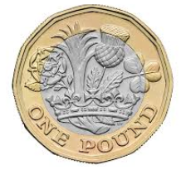
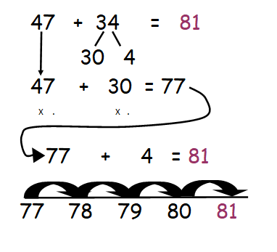
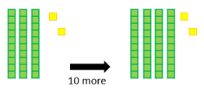
Y2 Objectives
1dn + 1dn + 1dn
2dn + 1dn
2 dn + 2dn (sum<100)
2dn + 1dn Use numbers in a context
Children to use the bar model
Augmentation structure
?
At first Fiona had saved £34 and then she added her £3 pocket money to that.
How much does she have now?
34
3
Key skills:
2dn + 1dn
2dn + multiples of 10
2dn + 1dn Use numbers in a context
What does each number represent?
+
£16
T
Os
2dn + multiples of 10
2dn + 2dn
Keep the first number whole
43 + 20 = 63

Slide 7
Appendix: Addition

Slide 8
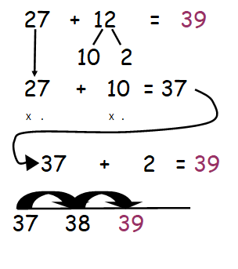
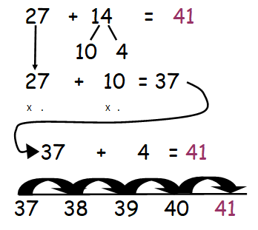
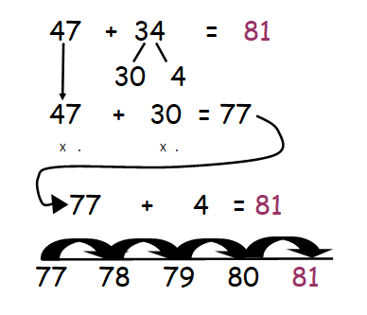
Small Steps | Example
2 digit + 1 digit (not bridging) | 24 + 3
2 digit + 1 digit (with bridging, counting in 1s) | 27 + 4
2 digit + 1 digit (with bridging, using facts to 10) | 27 + 4 (27 + 3 + 1)
2 digit + 10 | 27 + 10
2 digit + multiples of 10 | 27 + 20
2 digit + teens only (not bridging)
2 digit + low 2 digit (not bridging) | 27 + 22
2 digit + 2 digit (bridging 10)
2 digit + 2 digit (not bridging 100)

Slide 9
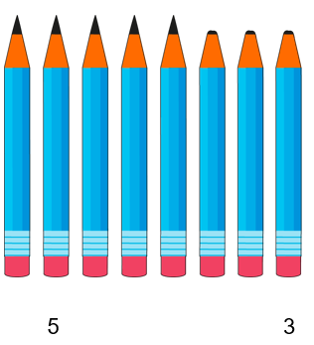
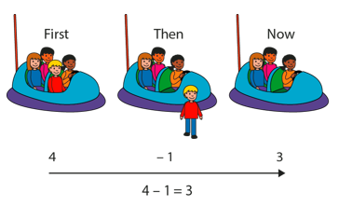
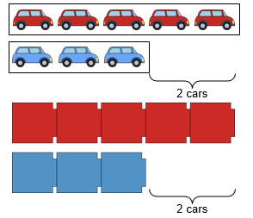
Subtraction – progression in written methods EYFS to Y2
Partitioning – the ‘not’ structure
Reduction
Difference

Slide 10
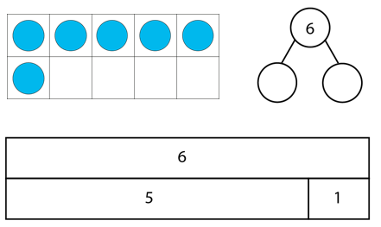
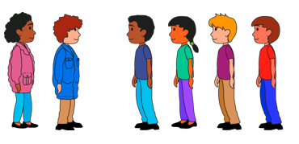
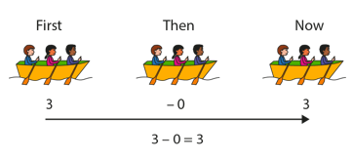
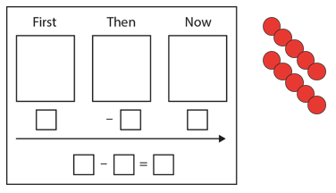
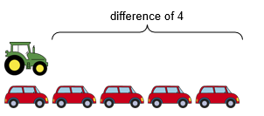
EYFS Objectives (ELG)
1 less
Subtract a single digit number from a single digit
Count back
Use part whole diagram (include zero)
Partitioning single digit numbers
Start with expressions (no = sign)
Key skills:
Subitise
Count back from any number
8 - 3
Move on to equations (has = sign)
Partitioning
Teacher to use the bar model in the summer term
Difference
6 - 2 = 4
Reduction

Slide 11
Y1 Objectives
Number bonds an related subtraction facts within 20
Subtract 1 and 2 digit numbers within 20, including zero
Use part whole diagram (include zero)
Partitioning single digit numbers
Key skills:
- bonds within 10
- bonds from 10
subtracting 0 and 1 from a number
Start with expressions (no = sign)
8 - 3
Move on to equations (has = sign)
Partitioning
Teacher to use the bar model.
Difference
6 - 2 = 4
Reduction

Slide 12
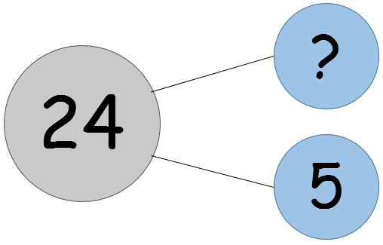
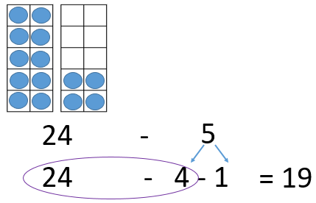
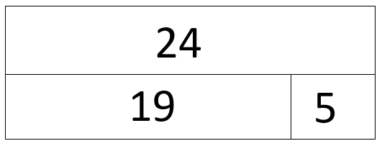
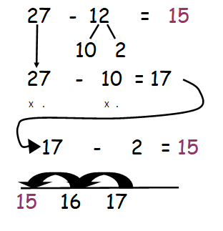
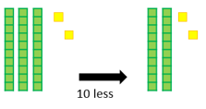
Y2 Objectives
2dn - 1dn
2dn – multiples of 10
2 dn - 2dn (sum<100)
Children to use the part whole and bar model
2dn - 1dn Use numbers in a context
Key skills:
2dn - 1dn
2dn - multiples of 10
At first Fiona had £24 and then she spent £5.
How much does she have now?
2dn - 1dn Use numbers in a context
What does each number represent?
-
£24
T
Os
2dn - multiples of 10
2dn - 2dn
Keep the first number whole
43 - 20 = 23

Slide 13
Multiplication and Division across the EYFS and KS1
EYFS | Year 1 | Year 2
They solve problems, including doubling, halving and sharing. | Count, read and write numbers to 100 in numerals; count in multiples of twos, fives and tens Double numbers to 20 | Recall and use multiplication and division facts for the 2, 5 and 10 multiplication tables, including recognising odd and even numbers Calculate mathematical statements for multiplication and division within the multiplication tables and write them using the multiplication (×), division (÷) and equals (=) signs
NCETM - Primary Mastery Professional Development
NCETM - Primary Assessment Materials
White Rose – Schemes of Work

Slide 14
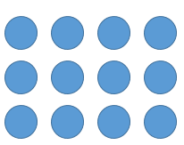
MULTIPLICATION KEY TEACHING POINTS
3 x 4 Is this 3 groups of 4 or 4 groups of 3?
At DIS we say: without a picture or a context to tell us which is the multiplicand and which is the multiplier, it can be either.
(N.B. White Rose follow the Shanghai way of working which only allows the multiplier first, so this would be 3 groups of 4; NCETM encourages children to see this both ways so is in line with our policy.)
Start by representing this with an array so that children can see both 3 lots of 4 and 4 lots of 3.
Also represent as repeated groups and

Slide 15
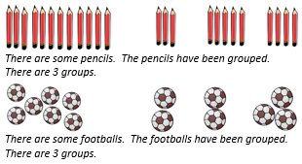
EYFS Objectives
solve problems, including doubling
Key skills:
Explore equal and unequal groups
double
Recognise the structure of doubling as 2 equal groups
Move on to exploring equal groups
There are two equal groups. There are 5 in each group. 5 doubled is 10.
Start by exploring unequal groups
Language used: unequal, equal, groups of, counting sets eg. 1 group of 5, 2 groups of 5 etc.

Slide 16
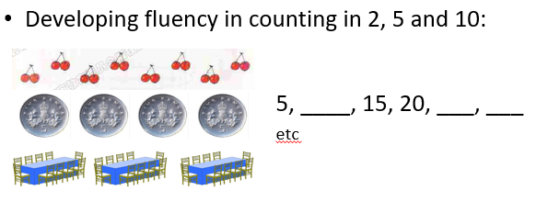
Y1 Objectives
solve one-step problems involving multiplication and division, by calculating the answer using concrete objects, pictorial representations and arrays with the support of the teacher
Key skills:
Explore equal and unequal groups
Skip count in 2s, 5s and 10s.
Recognise the structure of multiplication as repeated addition
Move on to exploring equal groups
Start by exploring unequal groups
Language used: unequal, equal, groups of, counting sets eg. 1 group of 5, 2 groups of 5 etc.

Slide 17
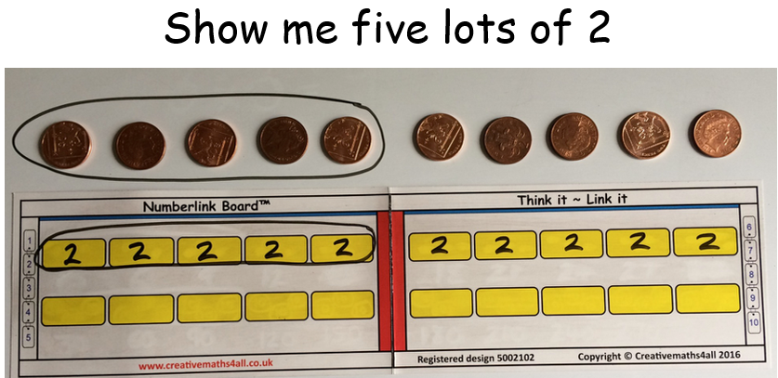
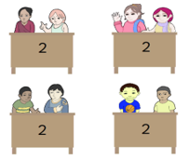
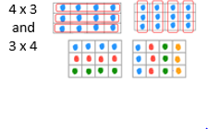
Y2 Objectives
recall and use multiplication facts 2, 5 and 10 multiplication tables
calculate mathematical statements using symbolic representation 2 x 5 = 10
show that multiplication is commutative eg. 2 x 3 = 3 x 2
solve problems involving multiplication using materials, arrays, repeated addition, mental methods, and multiplication facts, including problems in contexts
Use real life context examples
Recap on unequal and equal groups
Move from repeated addition to using the multiplication sign
Skip counting, counting in the … times table
2 + 2 + 2 + 2
2 x 4 or 4 x 2
What does each number represent?
Use arrays to draw attention to the commutative structure of multiplication
3 x 4 = 4 x 3
12 is equal to 3 groups of 4 or 4 groups of 3

Slide 18
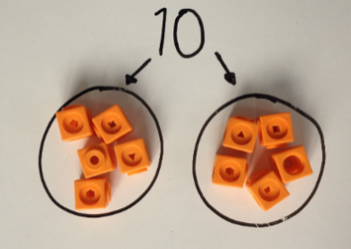
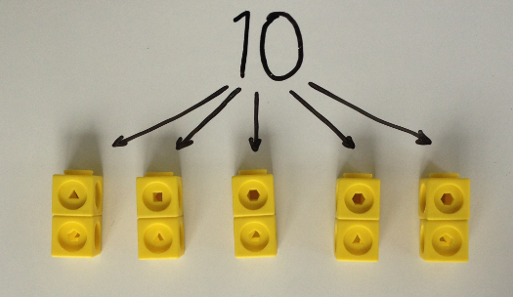
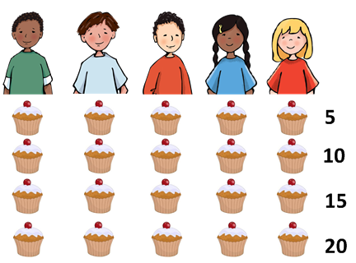
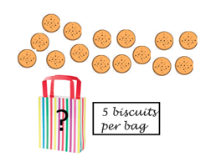
Structure and Language of Division
Division has two different structures that are explored separately.
Division as grouping (quotitive) : Division as sharing (partitive):
10 objects put in groups of 5 10 objects shared into 5 groups
How many 5s are there in 10?
The 5s are either kept together (quotitive) or the 5s are distributed (partitive).
I have 20 cakes and I share them equally between five people. How many cakes will they each get?
There are 15 biscuits and I put them into bags of five. How many bags do I need?

Slide 19
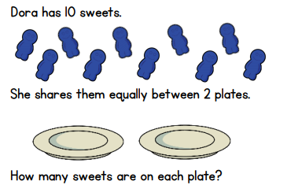
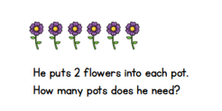
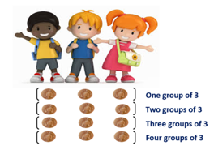
Y1: solve one step problems involving division using concrete and pictorial representations.
Y2: calculate mathematical statements using the division sign. Show that division is not commutative.
Use grouping (quotitive) and sharing (partitive) contexts as shown below.
Mo is putting 6 flowers into pots.
I have 12 pennies and I divide them between 3 children.
How many 3s are there in 12?
6 ÷ 2 = 3
What does each number represent?
12 ÷ 3 = 4
What does each number represent?
10 ÷ 2 = 5
What does each number represent?
For grouping and sharing contexts, move to a common language for division: “How many …..s in …….?”

