Slide 1
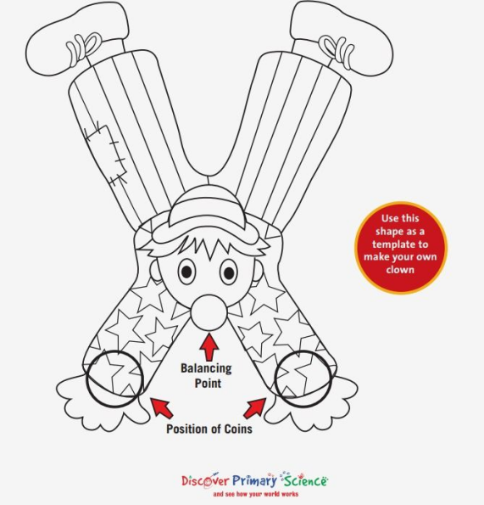
Can you make a Balancing Clown?
You will need:
Clown Template or paper
Coloured pencils or crayons
Card
Paperclips or coins
Sticky tape
Draw and decorate your clown, then stick it to card.

Slide 2
Put a paperclip or coin onto the clown’s arms.
Can you balance your clown on your fingertip?
Can you walk around and keep your clown balanced?
Look around the room.
Can you make a tightrope and balance your clown on the rope? What else can you balance your clown on?

Slide 3
How does it work?
It works as the paper clips or coins bring
the centre of gravity lower
than the item it is balancing on.
Send in any photos you have of this activity.

