Slide 1
Float or sink?
You will need:
A bowl of water
A range of objects (ideas below)
A marble
A pebble
A lollystick
A sponge
A cork
A ball
A leaf
How do we know if an object will float or sink?
Make a prediction or guess before you test each object.
It might help to hold or feel each object before you make your prediction. Then see if you were right.

Slide 2
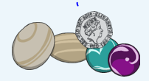
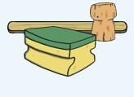
How does it work?
Objects like marbles, coins and stones have tiny molecules that are really close together. We say that they are more dense so when you put them in water, they sink to the bottom.
But objects like wood, sponge and cork have tiny molecules which are further apart so they float on water. Objects that are hollow also float because they have air inside them.

Slide 3
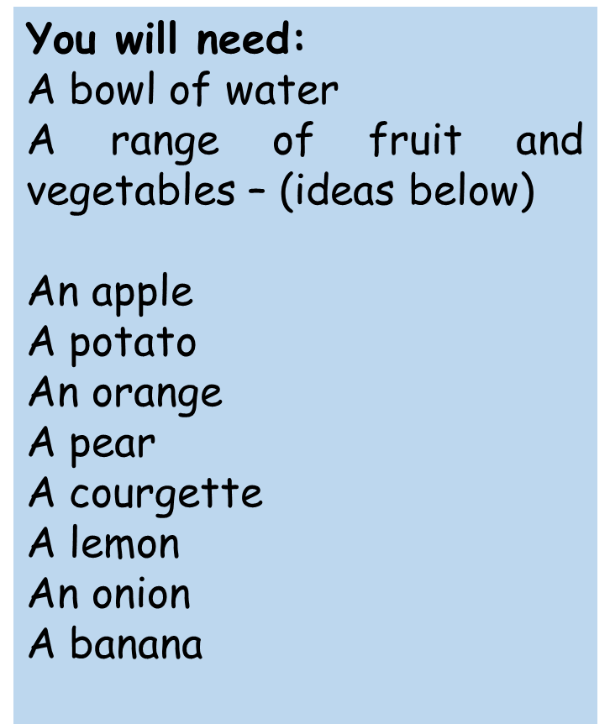
Do all fruit and vegetables float or sink?
Does an orange float when it is placed in water? Will a carrot sink?
Fill the bowl with water. Before putting in a piece of fruit or a vegetable predict if it will float or sink.
One at a time, place each fruit or vegetable in the water. As you place them in the water watch what happens.
Make a list of which ones Float / Sink.
What do you notice?

Slide 4
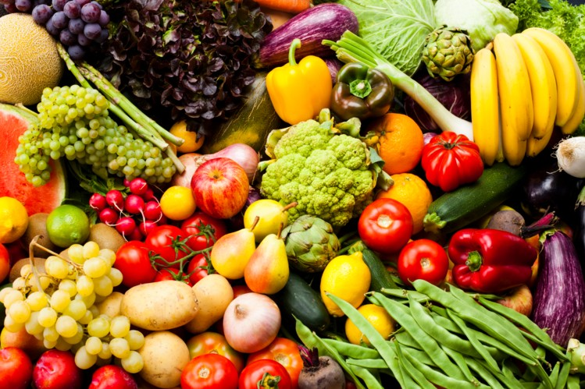
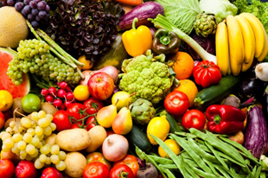
How does it work?
In general apples, oranges, pears, courgettes, bananas
and lemons will float while potatoes, carrots and turnips
will sink depending on its density. If the molecules are
close together they will sink but if they contain air
pockets or are futher apart they will float.
Send in any photos or results you have of this activity.

