Slide 1
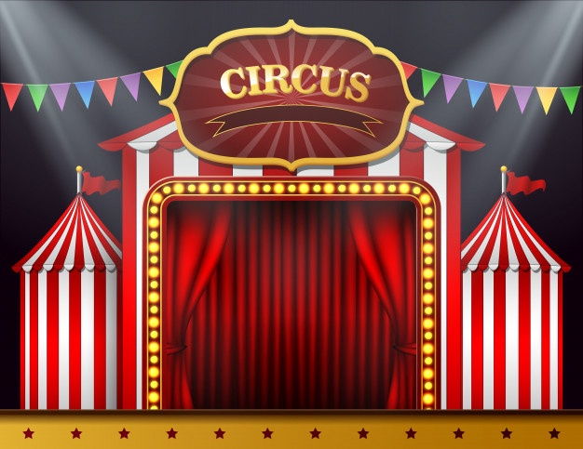
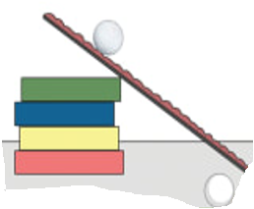
EYFS
Science
Clown Ball Rolling Experiment
You will need:
4 books
Plank of wood or stiff cardboard
Tennis ball
Ruler or Tape measure
Chalk

Slide 2
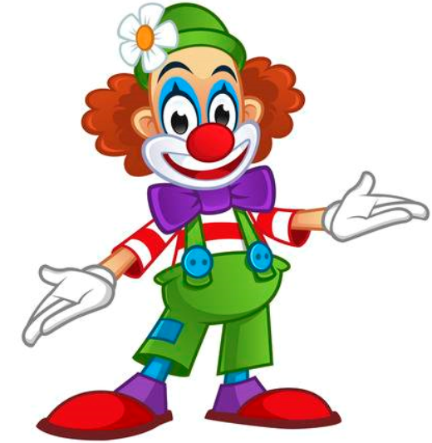
How does it work?
It works as gravity is pulling the ball down the ramp,
but there is also friction created by the two things
rubbing together so this slows the ball down .
1. Make a ramp using four books and
a plank of wood.
2. Roll a tennis ball down the ramp and
measure or mark how far it goes.
3. How could you make the ball go further without throwing it?
4. Try this again but use a two different
sized/ type of balls.
Q: Can you make your ball roll further?
Q: What if you roll the ball on a rough surface?
Q: Will the results be the same or will it roll even further?

Slide 3
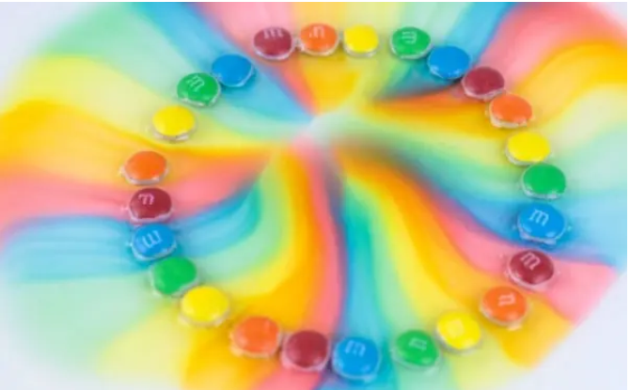
KS1
Science
Clowning around with Skittles
You will need:
Skittle sweets
Water
Plates

Slide 4
Q: Why don’t skittle colours mix in water?
Q: Could this skittles science experiment work with another type of candy?
Q: What would happen if you tried a different liquid and compared the results?
M&M Rainbow
Candy is a staple of the circus. Learn about dissolving, solutions, mixtures, and more in this fun candy dissolving experiment. The bright colours are also circus friendly!
How does it work?
While digging around for information, I learned about a term called stratification. The immediate definition of stratification is the arrangement of something into different groups which is a lot like we see with the skittle colours, but why?
Water stratification is all about how water has different masses with different properties and this may create the barriers that you see among the colours from the skittles.
STEP 1 : Empty out your skittles and check out the colours.
STEP 2: Next, lay out your plates in an area where they won’t be disturbed.
STEP 3: Now’s the fun part, make patterns! It’s up to you on how you want to place your colours. Make a rainbow or any sort of pattern that interests you. You can experiment with placing different colours next to each other.
STEP 4: Once you have your patterns placed, gently begin pouring water in the middle of the plate until it reaches all the candies and just barely covers them.

