Slide 1
Let’s learn about our senses.
Click on the link below to hear a song from
Nina and the neurons:
https://www.bbc.co.uk/cbeebies/watch/playlist-nina-and-the-neurons-songs#playlist
Then find the super senses song

Slide 2
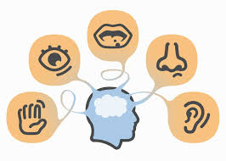
All our senses send messages to our brain.
Can you find something for each sense e.g
I can hear a car. (Hearing)

Slide 3
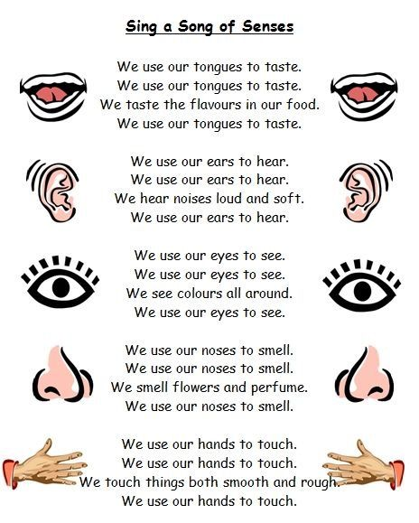
Look at this song about
Senses.
Can you make up your own?
If you do, why not send a copy into school.
Use the address below:
RWaters@dogsthorpe-inf.peterborough.sch.uk

