Slide 1
Hello children of DIS 👋
We are going to continue thinking about different emotions and feelings.
😀😍😞😢😡

Slide 2
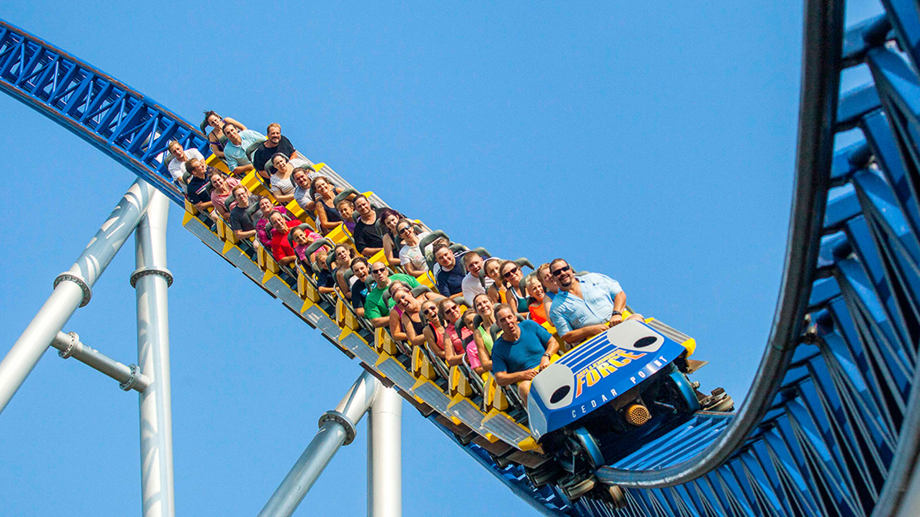
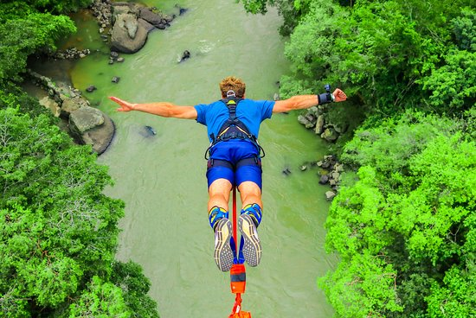
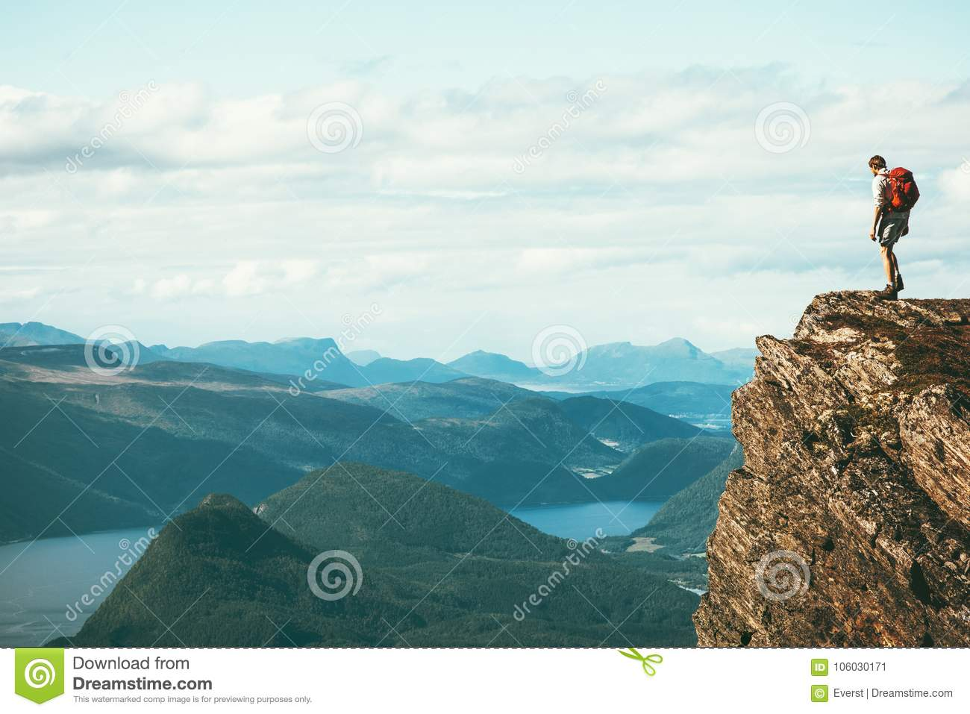
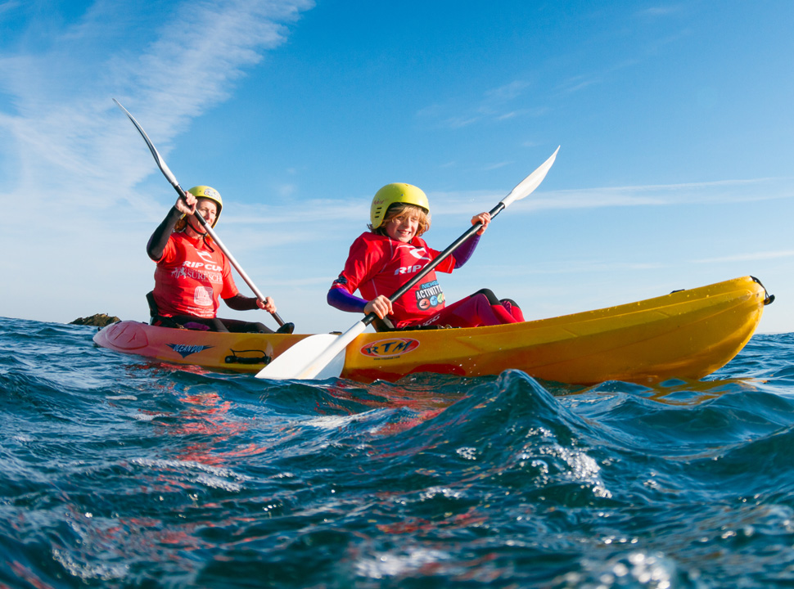
EYFS children – How do you think you might feel if you were in each of these pictures? What is the bravest thing you have ever done?

Slide 3
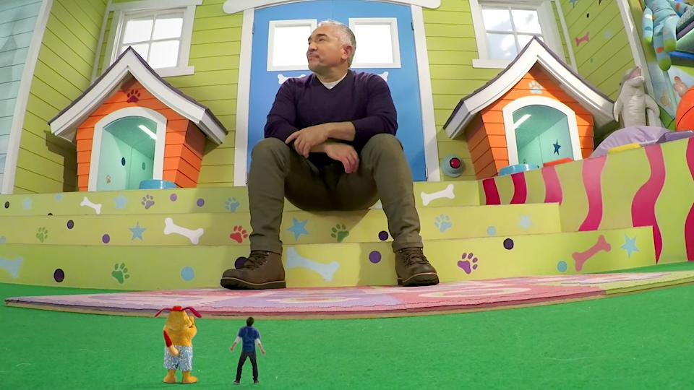
KS1 children – What if you shrank on your way out to play? How would you feel? What would playtime be like?

