Slide 1
EYFS - Keeping safe
This week we are going to be ‘At the Seaside’ so we have a some information about how to stay safe at the beach:
https://www.bbc.co.uk/cbeebies/watch/top-tips-for-staying-safe-at-the-beach#:~:text=Remember%20that%20even%20shallow%20water,in%20or%20near%20the%20water.&text=Always%20obey%20instructions%20from%20lifeguards,safe%20to%20swim%20or%20paddle.
What did you learn?
Can you remember all the things you need to do to stay safe?
Draw a picture of yourself at the beach.

Slide 2
Year 1 & Year 2 - Keeping safe
This week we are going to be ‘At the Seaside’ so we have a some information about how to stay safe at the beach:
https://www.bbc.co.uk/cbeebies/watch/top-tips-for-staying-safe-at-the-beach#:~:text=Remember%20that%20even%20shallow%20water,in%20or%20near%20the%20water.&text=Always%20obey%20instructions%20from%20lifeguards,safe%20to%20swim%20or%20paddle.
What did you learn?
Can you remember all the things you need to do to stay safe?
Now make a poster and remember to include all the safety information.

Slide 3
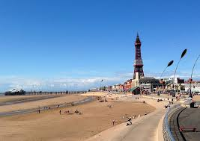
Listen and join in with the safety song below:
http://www.viewpure.com/cMTlBhyi66I?start=0&end=0

