Slide 1
Seaside Science
We normally go to the Seaside when it’s sunny. We need to remember some things to keep us safe outside.
Watch this story about keeping safe in the Sun:
http://www.viewpure.com/T7ghJsZug60?start=0&end=0

Slide 2
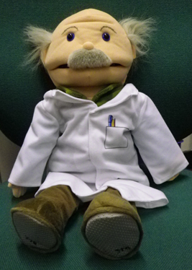
Hello, my name is Einstein. I am friends with Mrs Bland and she has set you a challenge below.
Challenge:
Design a hat for Einstein to wear to the seaside.
Think about which material will best and why?
Think about the colours you would use?
When you’ve drawn and labelled it. Send a picture into school.

