Slide 1
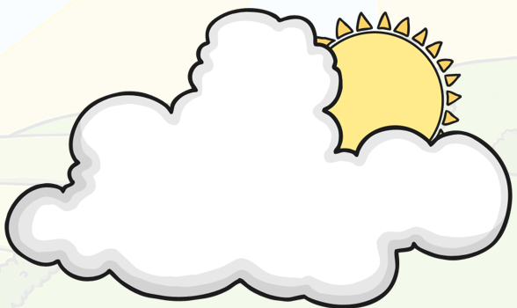
Hello DIS!
We have been learning about mindfulness at school this year. We have learnt how to help ourselves when we feel unhappy, mad, sad or stressed. Things are quite different for us all at the moment and you may be feeling worried and sad. We would like you to practise some of the techniques you have learnt to help you deal with these emotions.
You could ask your parents/carers to play this music while you do it.
https://www.youtube.com/watch?v=lFcSrYw-ARY

Slide 2
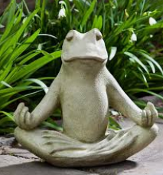
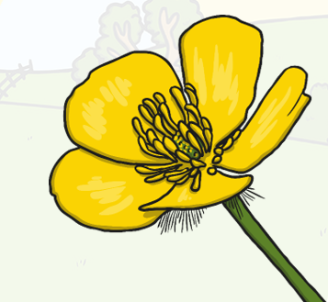
First of all can you practise sitting like a frog? Sit on the floor with
your legs crossed and hands on you knees.
Now practise breathing.
Sit up straight with your hands on your knees.
Breathe in like you are smelling a flower.
Breathe in like you are blowing a leaf away.
Practice a couple of times. Breathe in and out.

Slide 3
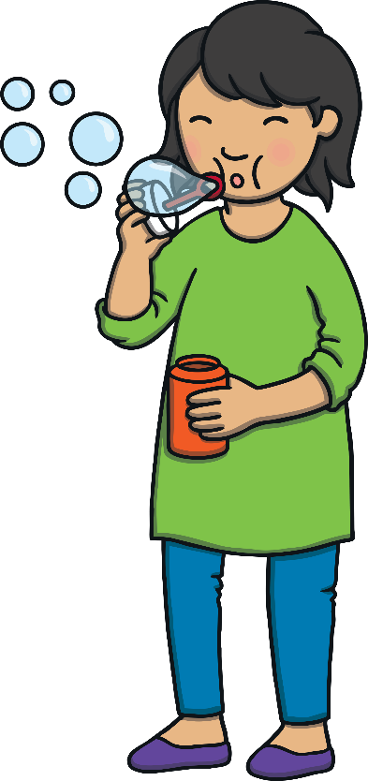
Bubble Breathing
Let’s pretend we are holding a bubble wand in our hand.
We are going to pretend to blow bubbles all around the room.
Breathe in deeply and breathe out slowly. Blow the bubbles around the room.
Let’s practice this a few times!

Slide 4
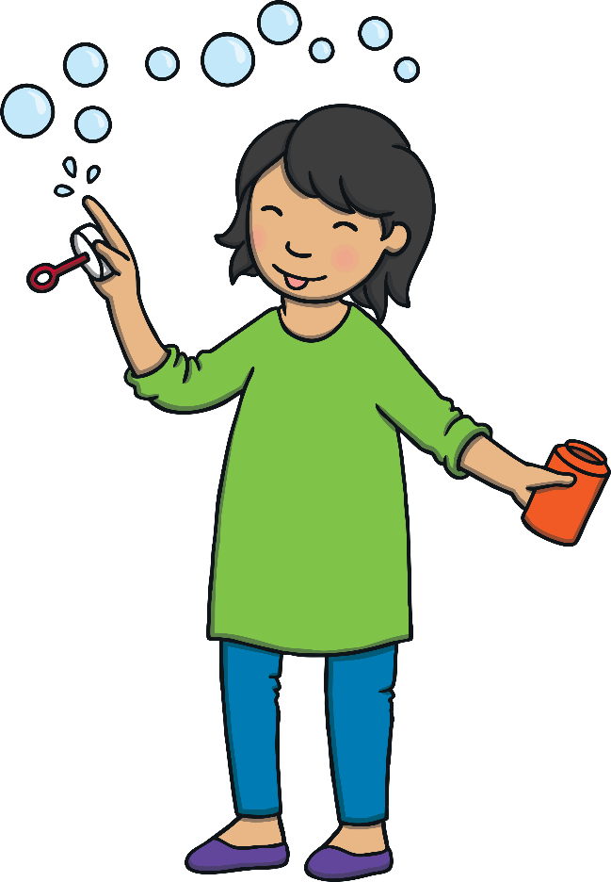
Bubble Breathing
Breathe in and breathe out. Imagine the bubbles have happy faces on them.
Blow happy face bubbles to your friends and family.
Imagine you are sending them happy thoughts and love.
Feel yourself becoming calm and relaxed with each breath.

Slide 5
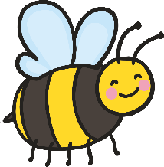
Bumble Bee Breathing
Now we are going to pretend to be bees.
Sit comfortably on the floor and open your hands out in front of your face.
Put your fingers over your eyes and your thumbs gently in your ears.
Breathe in through your nose and hum quietly like a bee as you slowly breathe out.

Slide 6
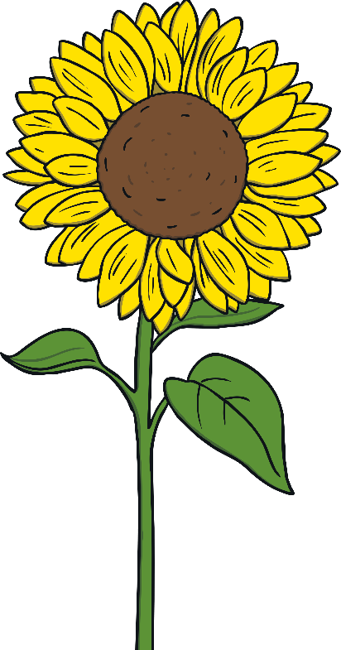
Bumblebee Breathing
Remember to hum like a bee. As you are humming, think happy and calm thoughts.
Pretend to be a bee buzzing around the flowers happily.

Slide 7
Rainbow Breathing
Now let’s stand up and make rainbows.
Put your feet shoulder-width apart.
Put your hands out in front of you with your palms facing out.
Reach up high with your hands above your head.
Move them down to your sides making a big arc.
You just made a rainbow!

Slide 8
Rainbow Breathing
Now we will practice breathing while we make rainbows.
Put your hands in front of you again.
Breathe in as your put your hands over your head.
Breathe out as you move them to your sides.
Each time we do this movement, pretend you are adding another color to your rainbow.
Feel how your body is relaxing and calming down.

Slide 9
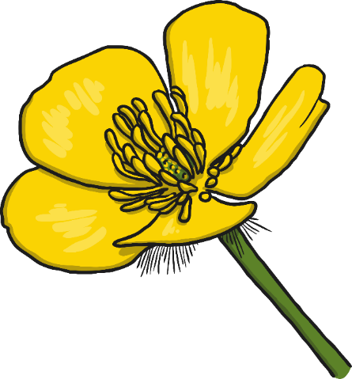
Great Job!
You did such a great job today!
How do you feel?
What was your favorite thing we did today?
Anytime you feel unhappy, stressed, mad or sad, you can do these activities.
Let’s take one last breath in and out.
Breathe in and smell the flowers and breathe out and blow the leaf away!

