Slide 1
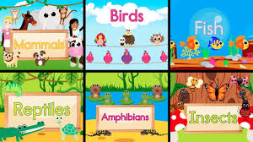
Animals
Did you know there are different types of animal groups?
Click on the link below and learn about them by singing the song!
http://www.viewpure.com/PHYi4fqeEdw?start=0&end=0

Slide 2
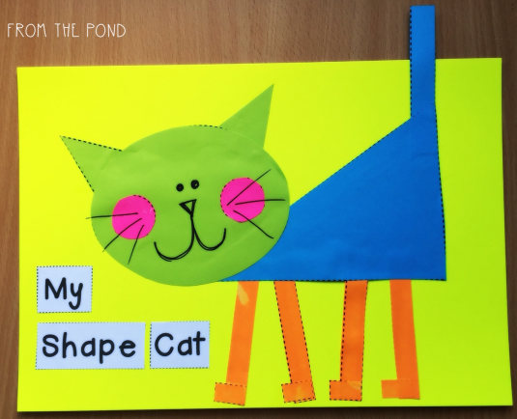
EYFS
Can you make an animal picture using 2D shapes?
Can you name any of the parts of the body?

Slide 3
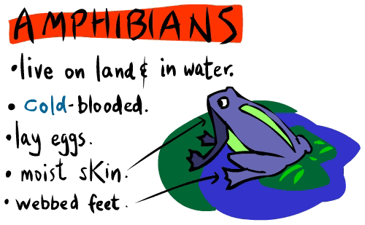
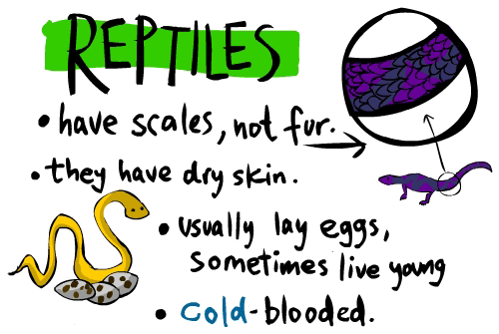
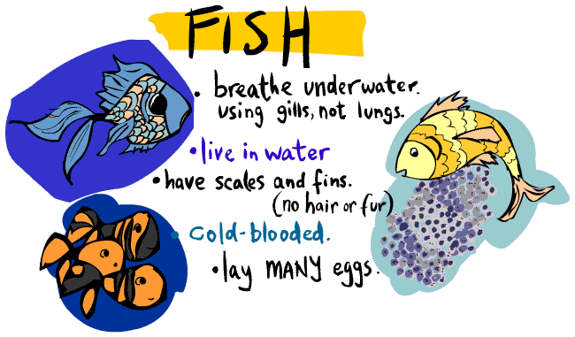
KS1
Can you draw a picture for each
of these animal groups?
Can you remember any of the facts?
If so, tell someone or write them down.

