Slide 1
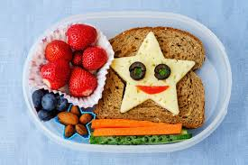
Keeping healthy
Can you name any ways to stay healthy?
Did you think of any of these?
Balanced diet
Exercise
Hygiene
On the next few slides choose as many of the activities or websites as you’d like.

Slide 2
Activity time.
Balanced diet – make a healthy lunch or snack.
Sing a healthy eating song using the link below:
http://www.viewpure.com/-JldSBUQB34?start=0&end=0

Slide 3
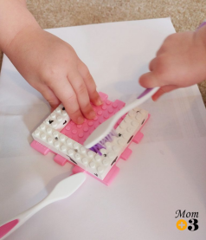
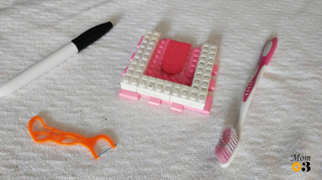
Hygiene – watch a video by clicking the link below about brushing your teeth.
http://www.viewpure.com/hDZXSMU2lAk?start=0&end=0
You can sing a song about brushing your teeth using the link below.
http://www.viewpure.com/wCio_xVlgQ0?start=0&end=0
Or have a go at making your own teeth out of lego.
You can put marks on the teeth and then you
Can try cleaning them with a toothbrush.

Slide 4
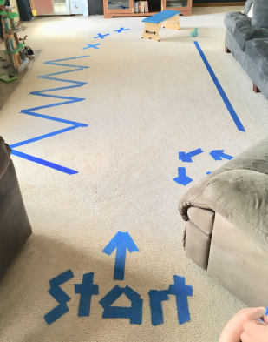
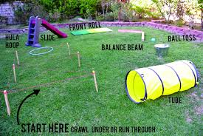
Exercise – The link below is a fun website with loads of different dances to do.
https://family.gonoodle.com/
Or why not make your own obstacle course to do.
Don’t forget to send in photos of you doing the activities!

