Slide 1
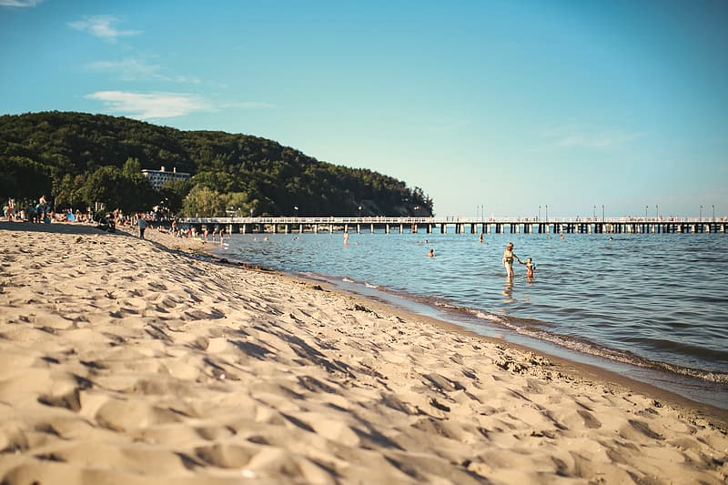
Seaside Science:
Did you know that the sea has salt in it?
It comes from two places:
Rocks on land have salt in them and this dissolves into the sea and also from vents which are found on the seafloor.

Slide 2
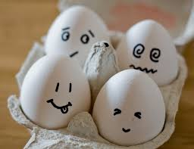
Let’s do a Sea Water activity.
You will need:
2 large bowls
Salt
2 eggs
tablespoons
Method:
Fill both bowls two-thirds full of water
In one bowl add 4 tablespoons of salt and stir until the salt has dissolved
Add one egg into the bowl of water without salt and see what happens.
Then do the same with the bowl which has salt and watch what happens.

Slide 3
How does it work?
The egg is denser than the water without salt so it will sink.
When salt is added this increases the density meaning it will be more dense than the egg, so the egg will float.
Some animals live in saltwater. Can you name any?
You might like to watch this video about the Octonauts and the Saltwater Crocodile:
http://www.viewpure.com/0jLLwbhwLW4?start=0&end=0

