Slide 1
Communication Strategies Workshop
November 2018

Slide 2
How can I help my child develop good communication skills?
In the first five years of your child’s life they will learn more about speaking and words than at any other time. Your child needs good speaking and listening skills to learn so it is really important that you help in the development of their language as much as possible

Slide 3
What can I do at home to help my child’s communication?
Get your child’s attention first before speaking or having a conversation. It often helps to get down to their level first wherever possible – this means having your face at the same level as theirs
Use simple, repetitive language. This works best if you try to keep your sentences nice and short
Use a full range of expression. This means speaking in a lively, animated voice and using some gestures and lots of facial expressions to make your words even more interesting
Model correct speech rather than correcting their mistakes

Slide 4
What can I do at home to help my child’s communication?
Try to reduce as much background distraction as possible, so doing things like switching the TV off can really help! Background noise can make it harder for children to pick up on new words. This is important because learning new words helps children to be able to use longer sentences
Playing and having time together is really important and you can use any toys or games that you already have at home
Following your child’s interest is also good for supporting their listening and talking. It helps if we show that we are paying attention and listening to them too. This really encourages children to pay attention and to listen to us. We can do this really easily as they play with a toy or carry out an activity.
Don’t be tempted to jump in; let them lead the play

Slide 5
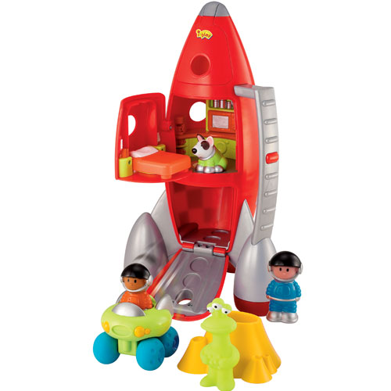
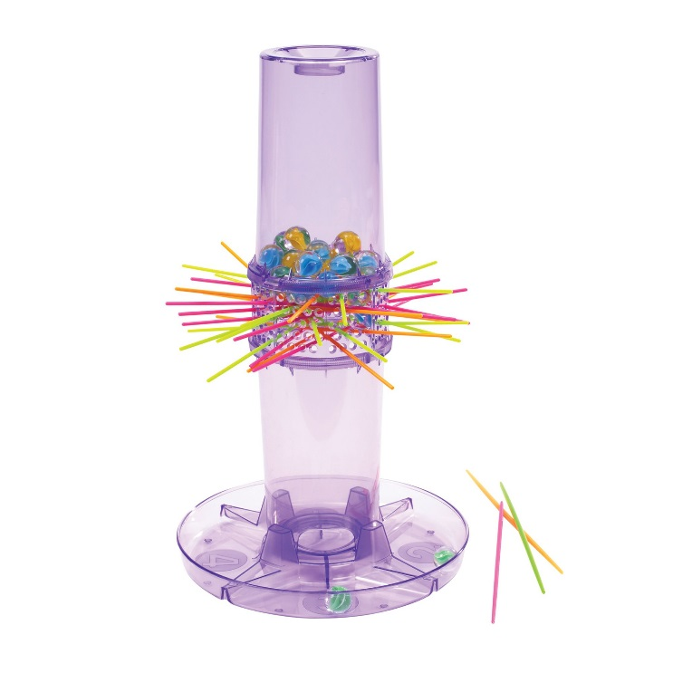
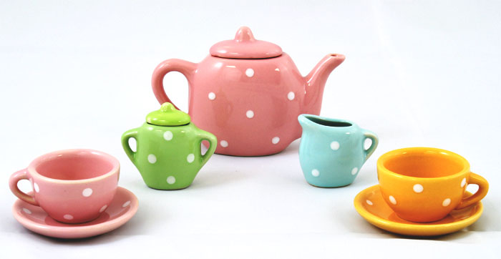
Ideas of toys, games and activities to support the development of communication skills
There are many toys, games and activities that can be particularly helpful for supporting communication. Here are some ideas…

Slide 6
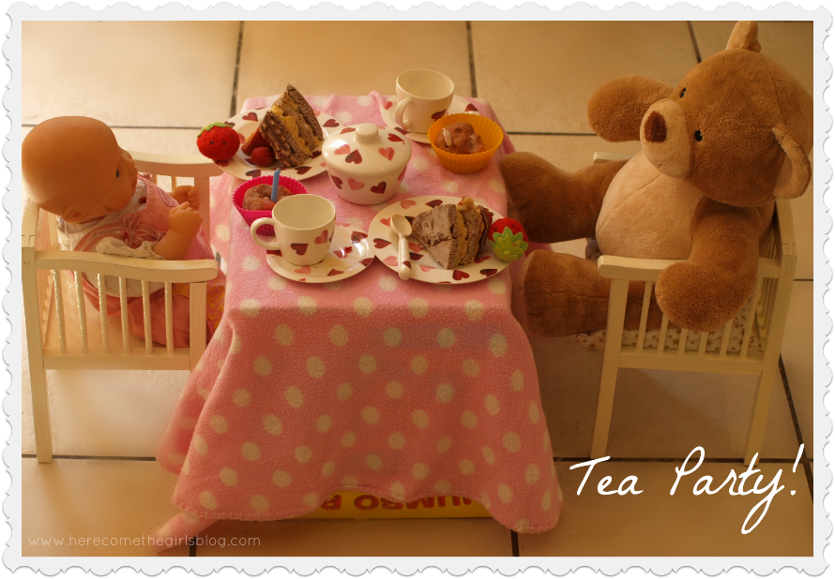
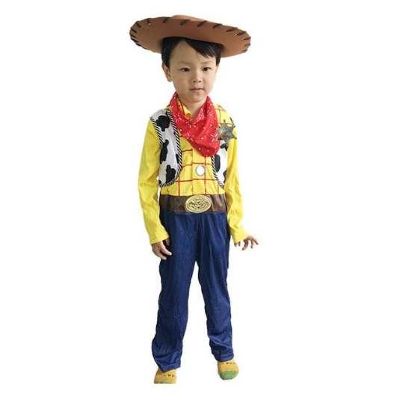
Imaginative Play
Imaginative play will help you expand your child’s language beyond what they can immediately see and it will help to develop their creativity.
Try to comment on what they are saying and doing as this will reinforce their language skills and will also show them that you are interested and listening to them
Examples of what you could use to develop imaginative play;
Dressing up
Doll’s houses
Teddy / dolly tea parties
Playmobile / happyland

Slide 7
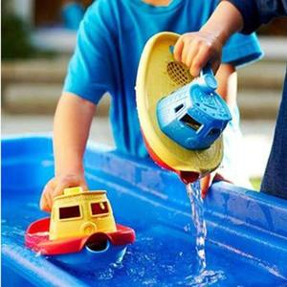
Messy Play
Messy play helps with sensory exploration and can be used to develop language skills. Messy play helps children to develop their awareness of different sensations and it can be used to talk about actions e.g. pour, squash, squeeze, pull, rub, as well as describing different colours and textures.
Some examples of messy play;
Water play
Sand play
Chalk boards
Finger painting
Playdough

Slide 8
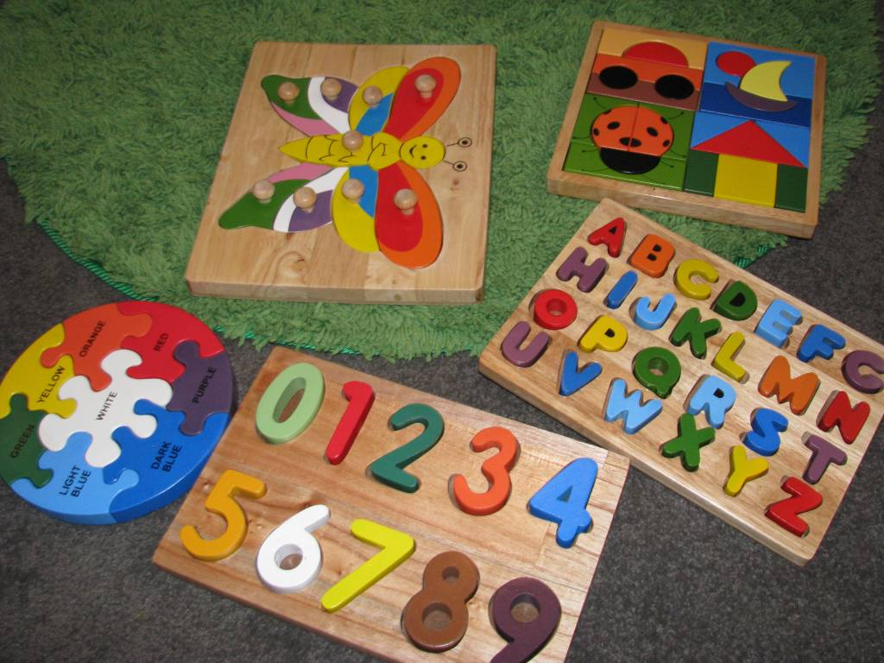
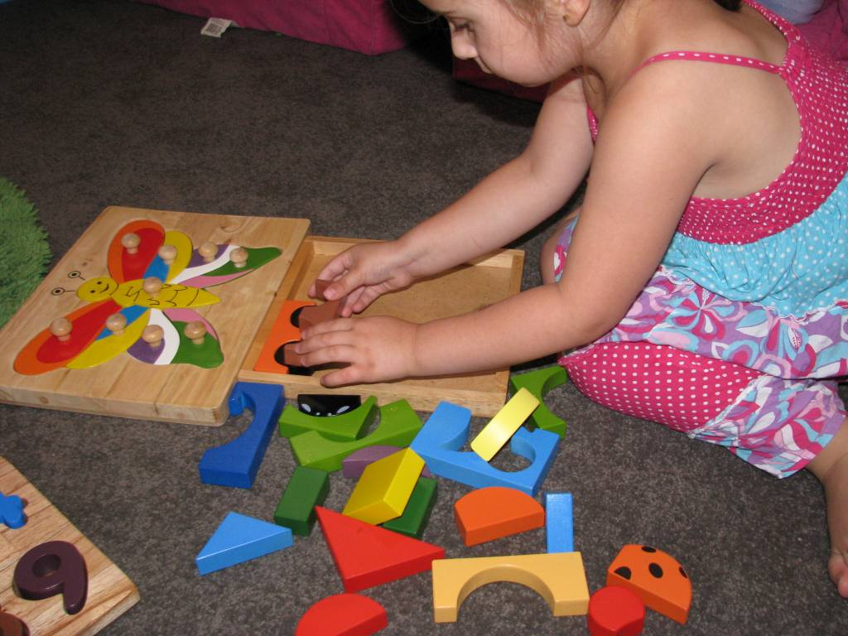
Inset Puzzles
You can use these puzzles to help your child build their vocabulary. Start commenting on the piece that they are putting in, then move on to giving them the choice “do you want the car or the fish?” before encouraging them to ask for what they want by saying, “which piece do you want now?”

Slide 9
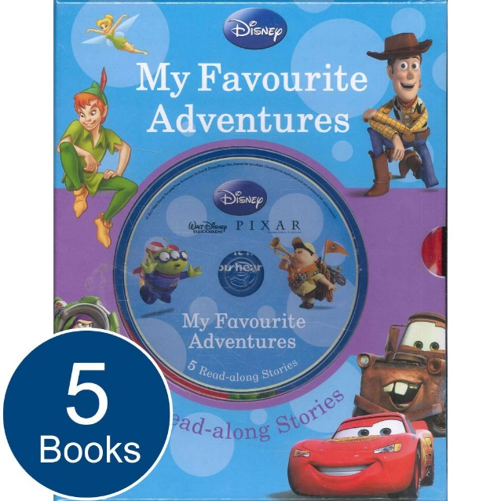
Listening to CDs, music, stories and sounds
Your child’s listening and attention skills are crucial for learning language. You can use listening to CDs to help build on these, and add information to what they are listening to.
For example, if they hear a cockerel crowing, you could talk to them about where the cockerel lives, what else you could find on a farm etc.

Slide 10
Repetitive Books
Repetitive books help children to listen and enjoy stories. Don’t be afraid to tell a story more than once, as repetition helps children to understand and remember the words that they hear.
Children love to join in with the bits that they remember and so books that have a repetitive line throughout them are great.
Examples of repetitive stories;
Dear Zoo
The Gingerbread Man

Slide 11
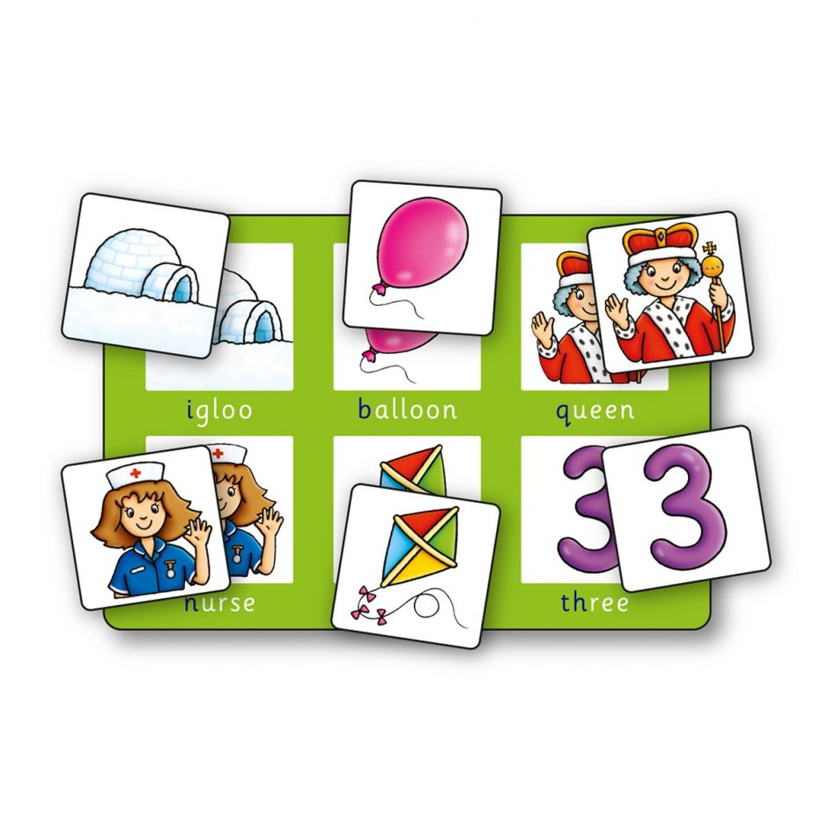
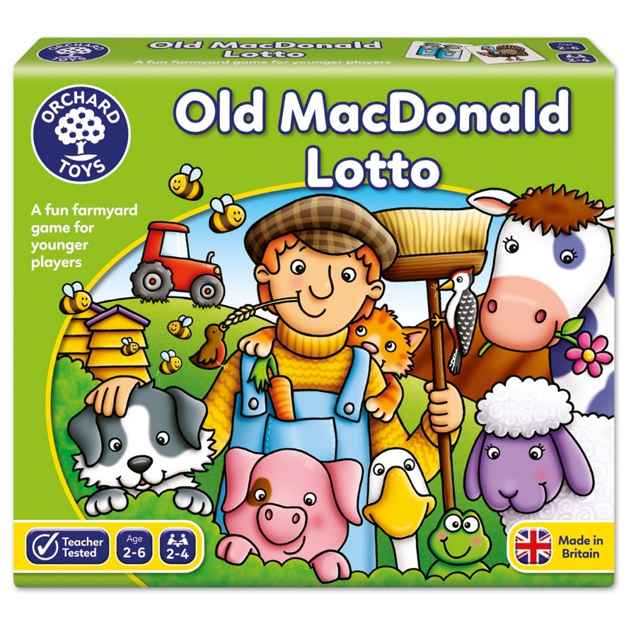
Simple Lotto Boards
Lotto boards are great for helping children to develop their vocabulary. You can talk to them about the pictures they find, and move on to asking them to tell you about the pictures

Slide 12
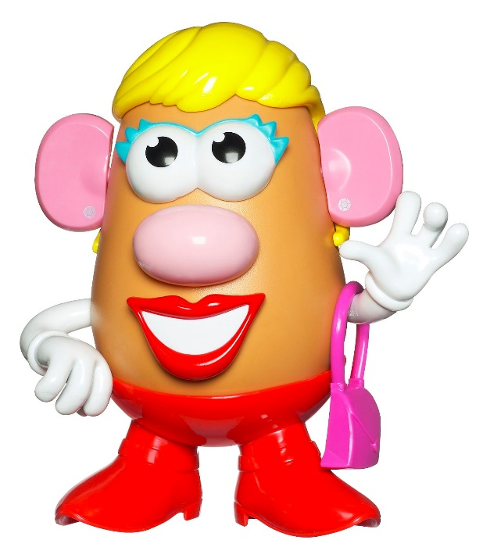
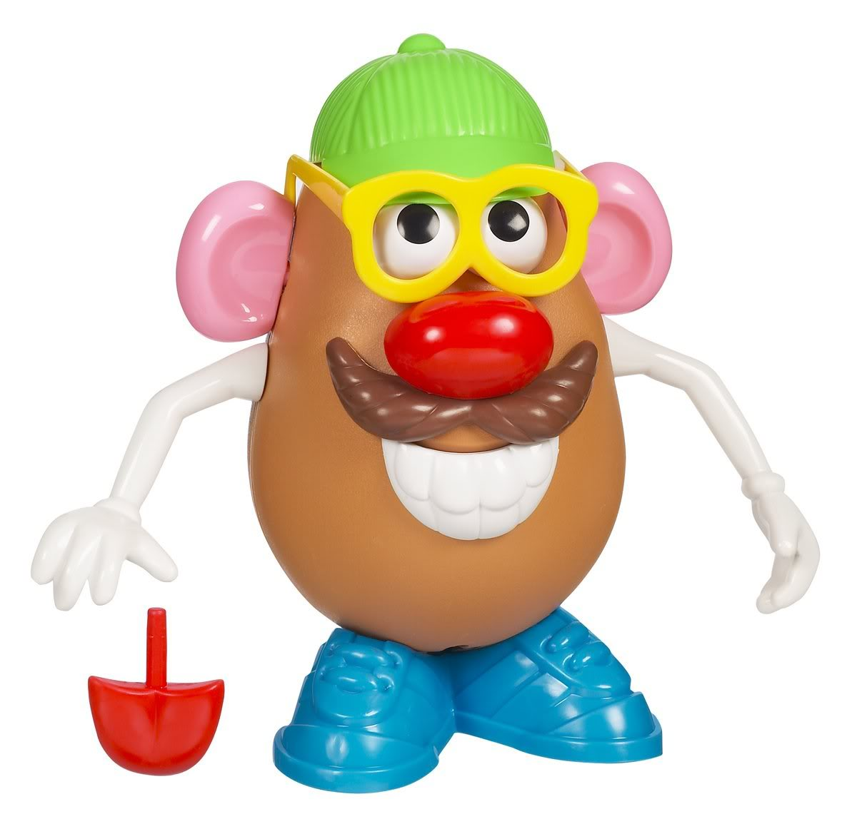
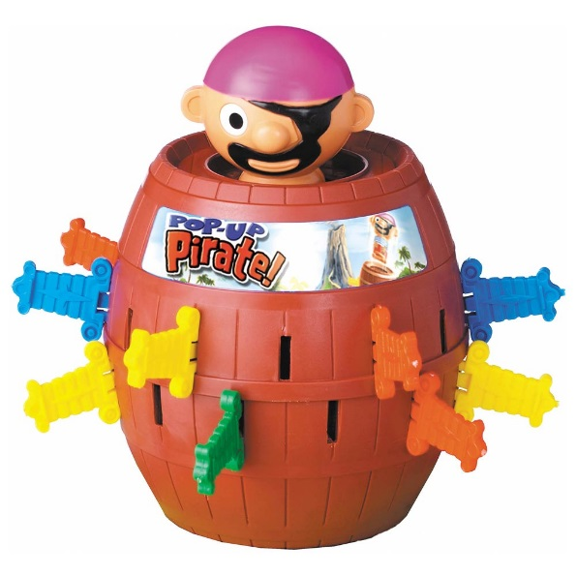
Colour and Shape matching and counting games and activities
These types of games will help your child learn important words that will be helpful to them in school. You can play these games together and talk about the colours and shapes that you can see.
Some examples;
Marble run
Mr Potato Head
Pop Up Pirate
Kerplunk
Lego

Slide 13
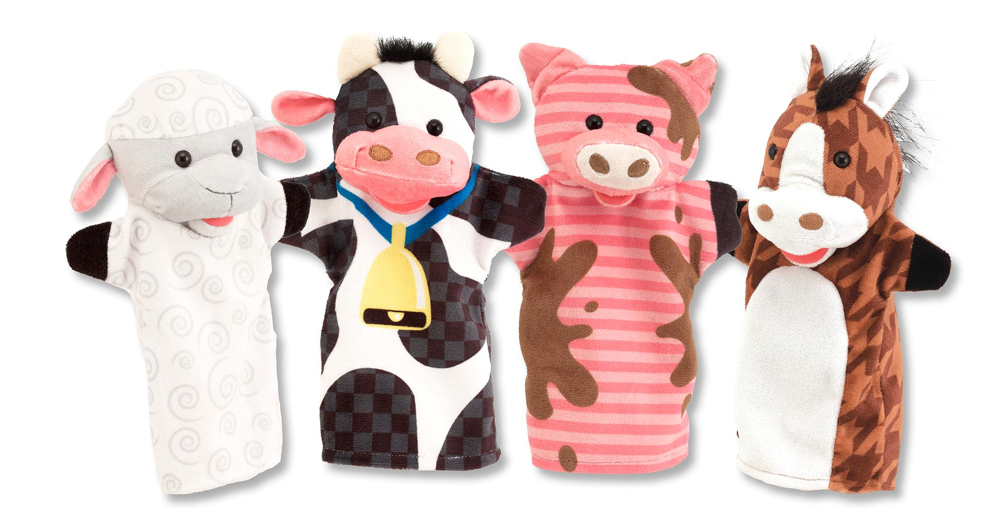
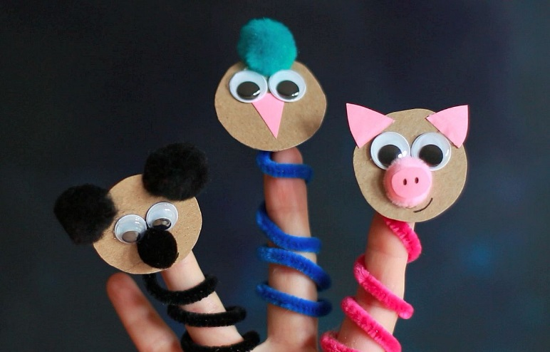
Puppets
Puppets are a great way to develop imagination and story-telling skills in children.
Make up stories and act them out with puppets, or re-tell familiar stories they already know.

Slide 14
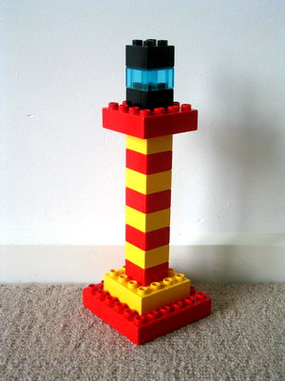
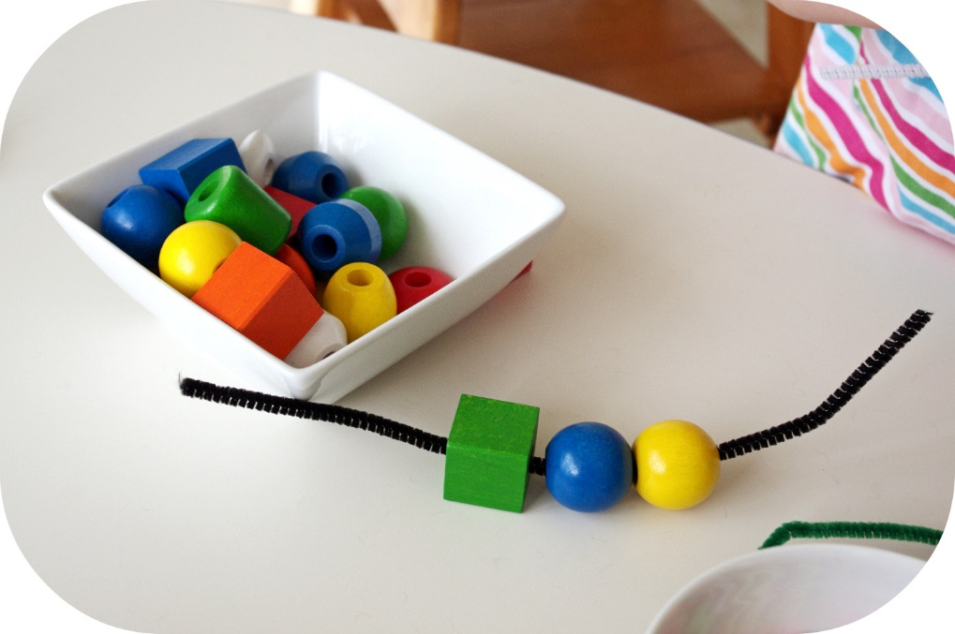
Sequencing Toys
It is always helpful to talk about time and sequences – play with and talk about sequences of coloured bricks or shapes as well as numbers and days of the week to encourage your child with words such as first, next, last, before, after
Activities to encourage sequencing;
Coloured bricks
Threading beads

Slide 15
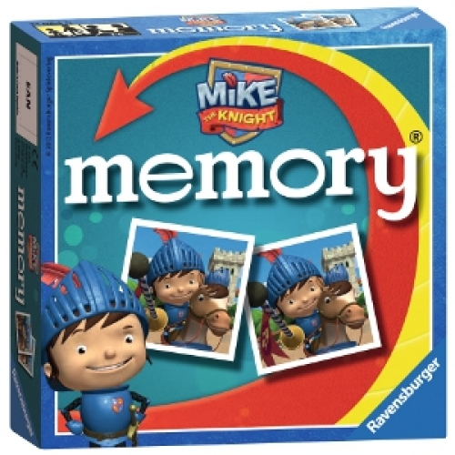
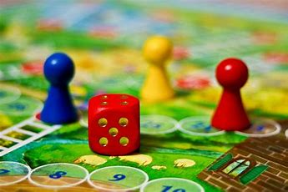
Board games and turn-taking games
Taking turns is an essential communication skill and playing any simple board game that involves taking turns not only helps children to develop this skill, it also helps them to listen and attend to an activity for longer periods of time.

Slide 16
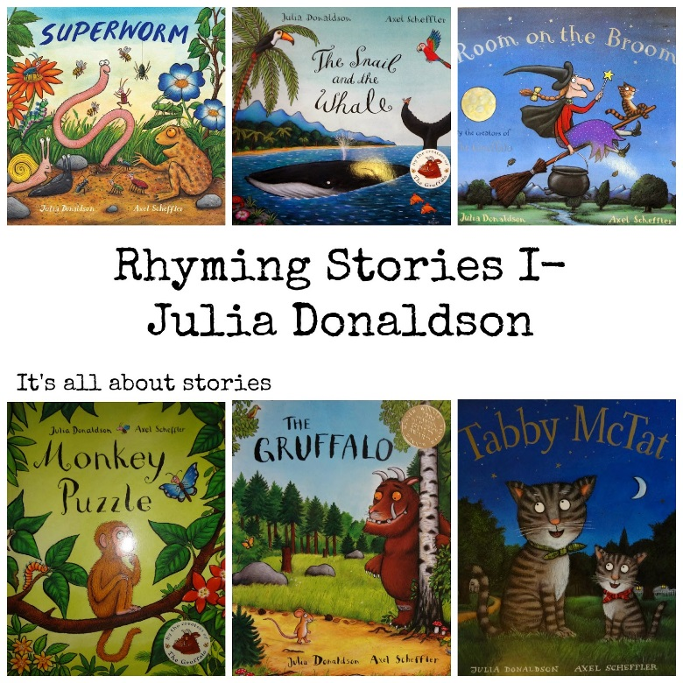
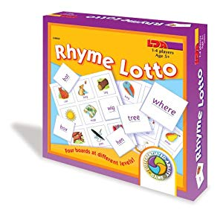
Rhyming Lotto and Rhyming Books
Having fun with words and rhymes can help children learn skills they need for reading and developing literacy.
By learning the differences and similarities between word sounds, your child will build the foundations for reading and writing.

Slide 17
Using Apps to support Speech, Language and Communication
There are many apps available which can support speech, language and communication
Cbeebies have a range of games and apps available
The National Literacy Trust lists a range of apps. You can search by your child’s age and the area of learning you would like the app to support
Smarty Ears has a range of different apps to support various language skills including adjectives, sentence building and describing
Super Duper Inc. Publications have a range of different apps for practising a range of different language skills
Speech with Milo has a range of apps available for developing children’s understanding and use of object words, actions, feelings, prepositions and putting ideas together
Splingo has a range of apps available for developing children’s understanding and use of object words and actions

Slide 18
Useful Websites
www.ican.org.uk/help
www.surreycc.gov.uk/family information service
www.talkingpoint.org.uk
www.nidcd.nih.gov (National Institute on Deafness and other Communication Disorders)
www.lucysanctuary.com (16 games to encourage attention and listening skills)

