Slide 1
A few more ideas that you can do, while you are thinking about
‘Your next BIG adventure’
These are some of the activities that your friends will be doing in school, we thought it would be nice if, even though you are not together, you can think of each other while joining in with the activities.

Slide 2
Listen to the story ‘The Invisible String’.
I wonder who you miss, in school or in your family?
Could you think about your invisible string and how it holds EVERYONE together, not matter where we all are.

Slide 3
If you are feeling sad or worried, that’s okay, we all feel like that sometimes.
Picture something that makes you feel happy and calm and then either draw a picture or right about it.
You could write about your fantastic memories of Dogsthorpe Infant school. Was what the best thing about Reception, Year 1 or Year 2?
We would love to hear and see what you think?

Slide 4
My Memories of DIS
Year 1
Year 2

Slide 5
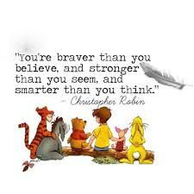
Book ideas
Remember that it is okay to feel worried or sad about things changing, we all feel like that sometimes. Ask your grown-ups how they feel when things change.
Ideas for moving on books
https://youtu.be/-zcqzXFG_ng – A Cautious caterpillar who does not like change.
https://www.youtube.com/watch?v=TQ0wyzjr5mg - Jacks worry
https://youtu.be/NLEP-VbO0mc
Bernstein Bears moving to a new school

