Slide 1
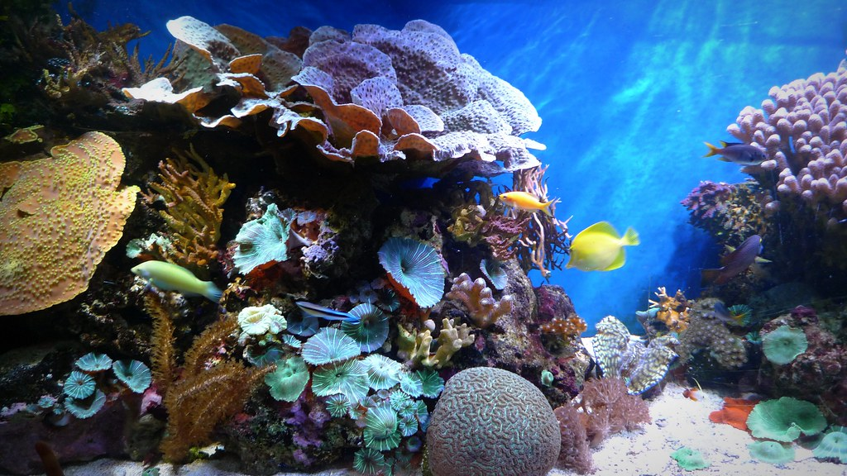
Science: Under the sea
Did you know that the sea is split into different zones?

Slide 2
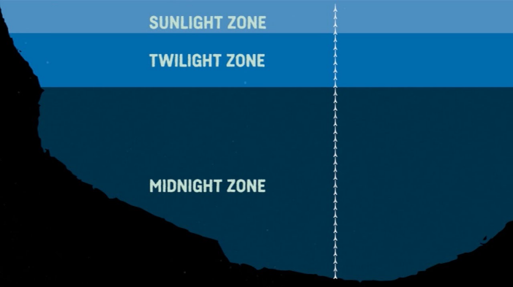
Watch this video about the Octonauts and the lost sea star:
http://www.viewpure.com/F8M76gXAFls?start=0&end=0
It will tell you about the different zones in the sea.

Slide 3
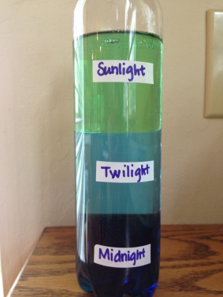
Let’s make the Sea Zones in a bottle.
You will need:
A plastic bottle
Blue food colouring
Vegetable oil
Water
Method:
Fill the bottle half way with water
Add 10-15 drops of food colouring
Fill the rest of the bottle with vegetable oil
Put the lid on tight and shake it up
Then when it settles it should have three distinct layers; sunlight, twilight and midnight.

