Slide 1
PSHE Looking after our world
This week we are going to be ‘Under the Sea’ so we have a story about something happening in our underwater world.
http://www.viewpure.com/i1_37YGzXrc?start=0&end=0
Did you enjoy the story? Why?
Who was your favourite character in the story? Why?
Did you spot the problem?
Draw or make a picture of the characters.

Slide 2
PSHE Looking after our world
Can you think of different ways we can look after our world?
Can you Reduce, Reuse, Recycle, like the story suggests?
Check that you are recycling items at home.

Slide 3
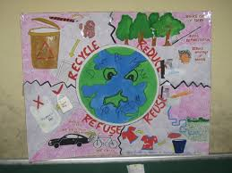
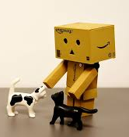
PSHE Looking after our world
Choose from the activities below:
Play this recycling quiz on the link below:
https://www.bbc.co.uk/cbbc/quizzes/bp-are-you-a-recycling-master
Make a Reduce, Reuse, Recycle poster or picture.
Upcycle an old item into something new.

