Slide 1
Let’s go to the circus!

Slide 2
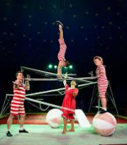
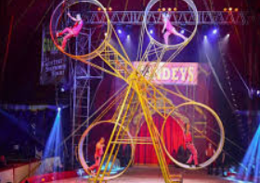
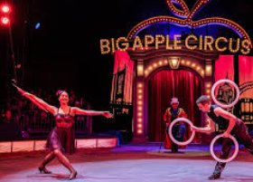
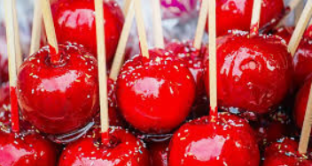
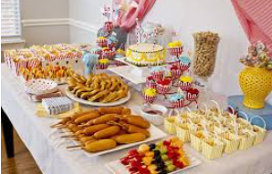
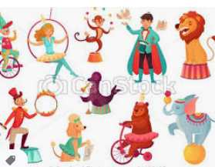
Have you ever been to the circus? Today we are going to go on a journey to the circus through your senses. Your family can come too!

Slide 3
Watch the following clip. http://www.viewpure.com/UKTV5vNLj1Y?ref=bkmk
Then, while listening to the music discuss these questions with your family. http://www.viewpure.com/zjedLeVGcfE?ref=bkmk
What can you hear?
Can you imagine all of the things you might see?
Is that popcorn I can smell?
What else can you smell?
I’m getting excited! How do you feel at the circus?
Ask your families how they feel too. Do you all feel the same?

